Slide 1
Security Documentation: Guidelines
Policies
Standards
Procedures
Guidelines
https://frsecure.com/blog/differentiating-between-policies-standards-procedures-and-guidelines/

Slide 2
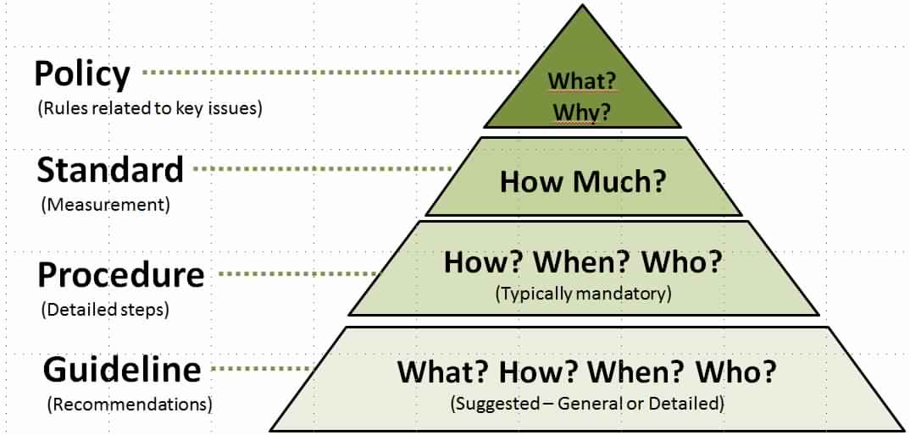
Security Documentation: Guidelines
https://frsecure.com/blog/differentiating-between-policies-standards-procedures-and-guidelines/

Slide 3
Security Documentation: Guidelines
Guidelines
Guidelines are recommendations to users when specific standards do not apply. Guidelines are designed to streamline certain processes according to what the best practices are.

Slide 4
Security Documentation: Guidelines
Guidelines
Guidelines, by nature, should be open to interpretation and do not need to be followed to the letter.

Slide 5
Security Documentation: Guidelines
Guidelines
Are more general vs. specific rules.
Provide flexibility for unforeseen circumstances.
Should NOT be confused with formal policy statements.
END

